Slide 1

VirtuaLgym
Turma 6, Grupo 5
Diogo Sousa, up202103341
José Santos, up202108673
Sara Azevedo, up202006902

Slide 2
Project’s idea description
The main idea behind this project is, as the name suggests, a kind of virtual gym with video and images explaining to users how to carry out the proposed exercises.
The application will have personalized training plans for the different user needs (toning, muscle gain or working out in general) and will also have various nutritional plans available.
To maintain user focus throughout their fitness journey, our app has the capability to set personalized goals for body weight and daily calorie intake. Additionally, users can conveniently schedule workout notifications to ensure they can be reminded to stay committed to their fitness routines.
In short, our main goal is to make this application satisfy every gymgoer's wants and needs.

Slide 3
Related apps / services / systems
While researching services that offer similar capabilities to our app, we encountered several options.
The feature of providing diverse training plans tailored to the user's goals is a common trait among many fitness apps, with Fit Star and Boost Plan serving as prime examples. In terms of nutrition planning, both the Nike Training Club and 8Fit Workout & Meal Planner apps stand out for their personalized plans and comprehensive nutrition guidance. Additionally, apps like Freeletics and Gym Life excel in progress tracking and offer a variety of workout options.
In conclusion, our investigation revealed various services that encompassed our app's different functionalities but within a broader context. However, we did not find any single service that comprehensively covered all the functionalities we offer.

Slide 4
Questionnaire Highlights who, how, how many…?
25 answers
76% were aged between 20 and 30 and the other 24% were 20 years old or younger
60% were male and the remaining 40% were female
48% worked out 3-4 times a week, 28% 1-2 times a week, 12% 5-6 times a week and the remaining 12% didn't workout at all
40% aimed for muscle gain, 36% targeted wight loss and 24% wanted to maintain fitness
88% didn't follow any specific work out programs or routines
76% didn't track their workout, 16% tracked it with a fitness app, 4% with wearables and the remaining 4% with “Avaliação com PT”
84% preferred a gym app with pre-made work out plans rather than customizable plans
80% prefer workout instructions in video than image
88% would like the app to offer personalized workout and nutrition recommendations tailored to their fitness goals, preferences and restrictions

Slide 5
PACT Analysis
People:
For people of all ages
Activities:
Physical exercise practice
Maintaining a balanced diet
Contexts:
At the user's home or at the gym
Technologies:
Access to user’s camera, photo gallery and internet.

Slide 6
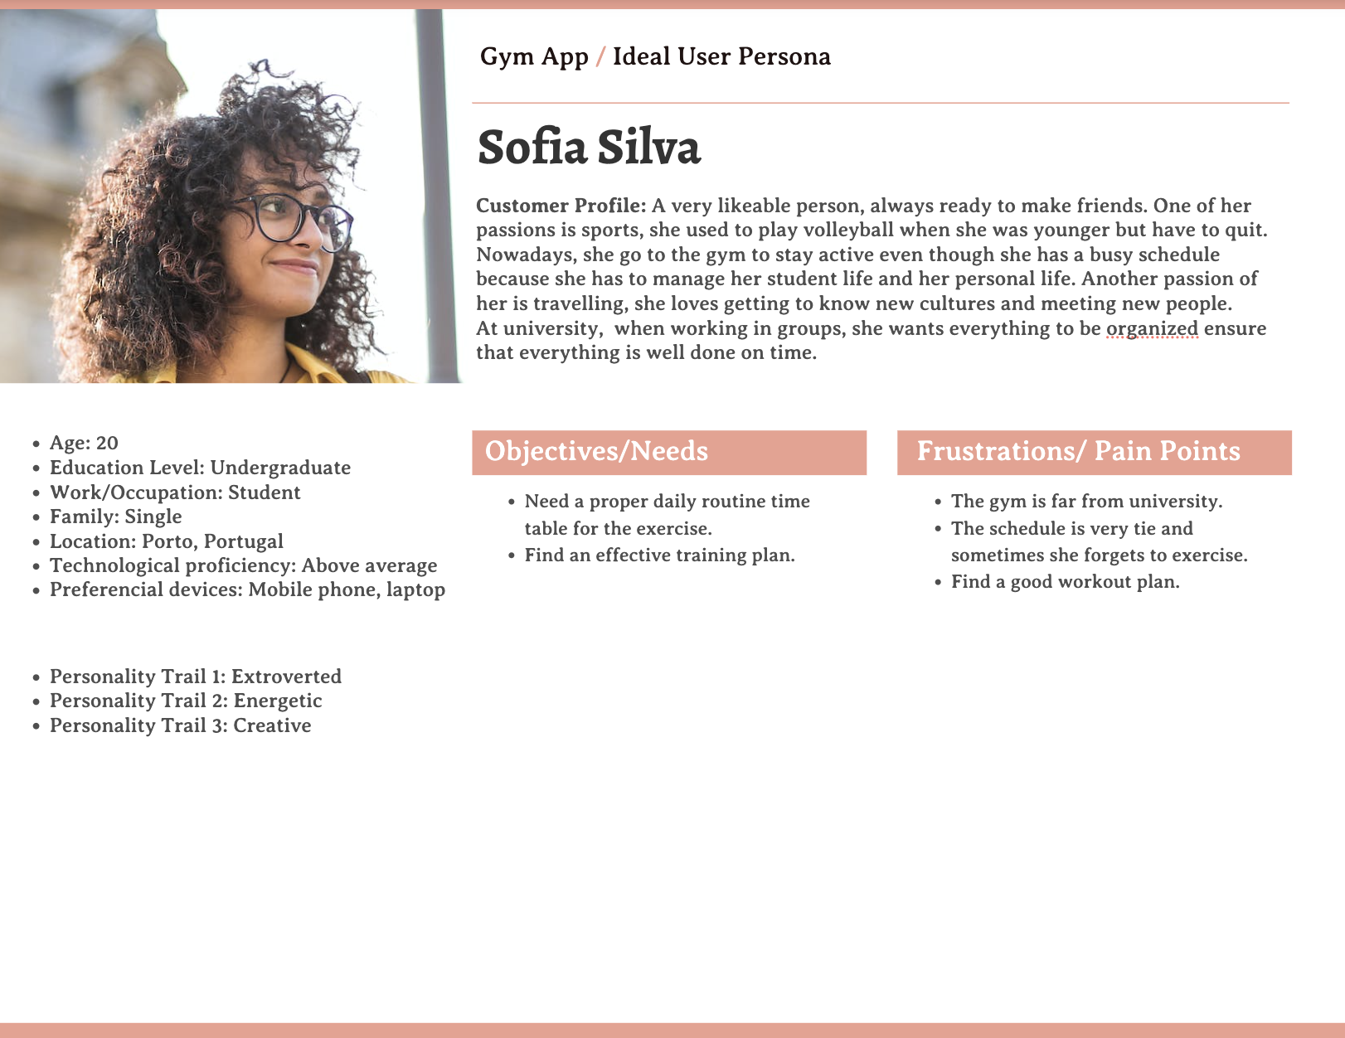
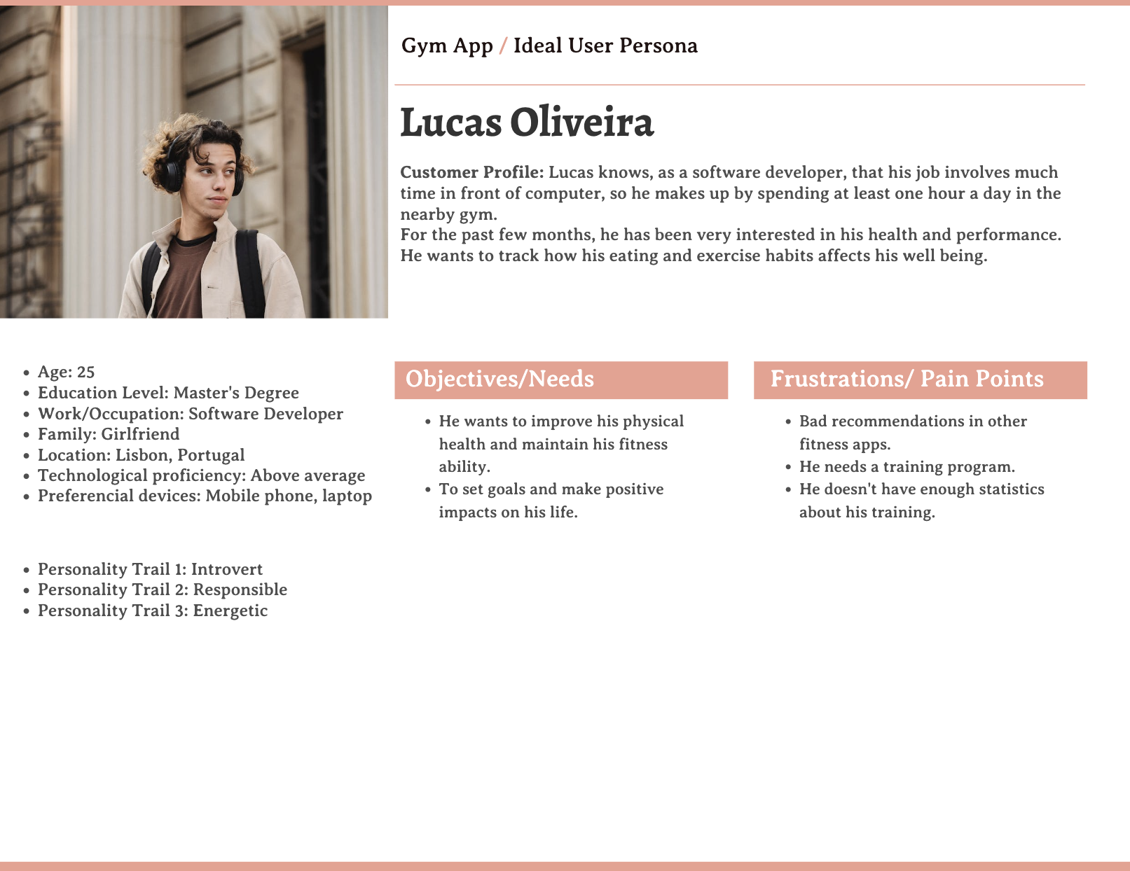
Personas

Slide 7
Functionalities and tasks
Functionalities:
Register in the app, adding a profile picture (optional), a name, an email and a password.
Remove and edit the profile picture
Change the different needs of the users
Access to nutritional programs
See progress over time
Tasks:
Choose the workout that you want
Set goals
Set reminder to workout

Slide 8
Activity scenarios
Scenario 1:
Lucas gets home from work and wants to start his daily workout. He opens his fitness app on his phone.
The app shows him today's workout plan with details like exercise type and duration. Lucas reads through the workout instructions and heads to his workout area.
Using the app, he follows the exercises, and it helps him with timers and reps. After finishing, Lucas records his progress in the app to track his fitness journey.
Scenario 2:
Lucas checks his app dashboard to see how he's been doing. He realizes he's made progress but can do better.
He looks at a report showing his calorie intake, workout intensity, and sleeping patterns over the past few months.
Lucas is happy to see that some changes in his diet have boosted his energy and recovery.
With this info, he tweaks his workout and meal plan and sets new goals.

Slide 9
VirtuaLgym

